Slide 1
RADAR USING ARDUINO
SARANATHAN COLLEGE OF ENGINEERING (Department of Information Technology)
Khavyaa S - 204020
Nilani P - 204029

Slide 2
Abstract
Radar is a long-range object detection system
This Arduino Radar Project is based on Sonar technology which uses an ultrasonic sensor to determine the presence of any object in a particular range.

Slide 3
EXISTING MODEL

Slide 4
LIMITATION OF EXISTING MODEL

Slide 5
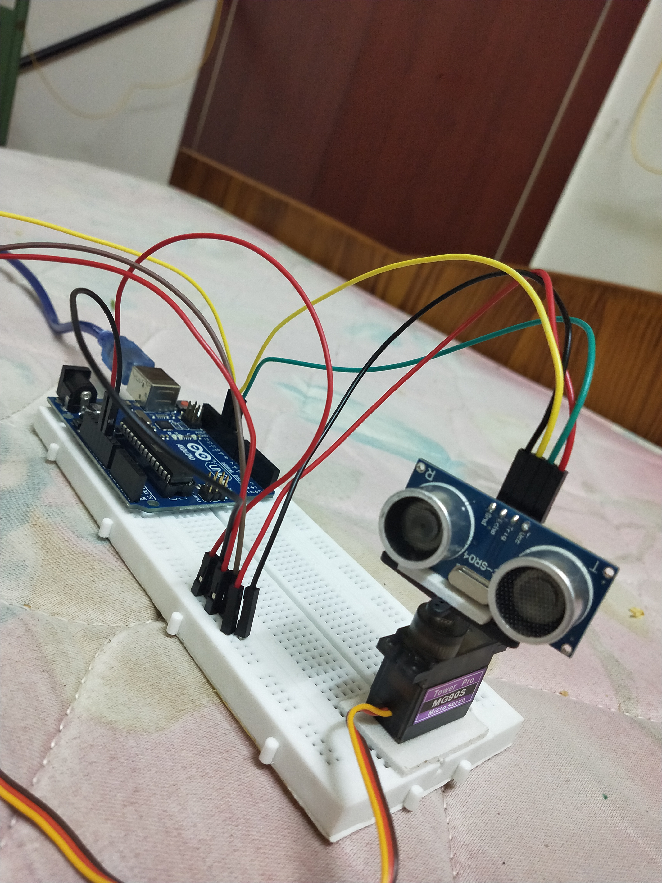
PROPOSED IDEA
Boating
See where you cant
Enhanced Situational Awareness

Slide 6
Components Required:-
Hardware
· Arduino UNO
· HC-SRo4 Ultrasonic Sensor
· TowerPro SGgo Servo Motor
· Connecting Wires
· Jumper Cables
· 5V Power Supply
· USB Cable for Arduino
Software
· Arduino IDE
· Processing Application

Slide 7
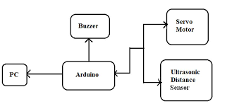

Slide 8
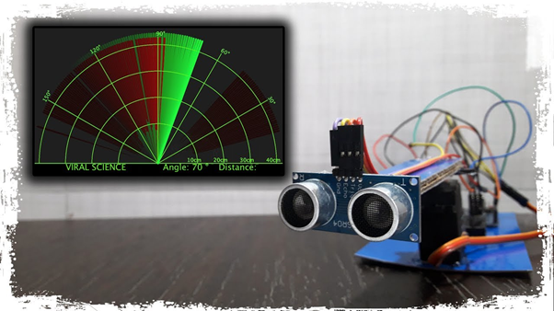

Slide 9
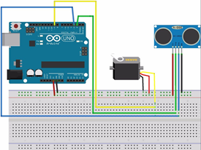
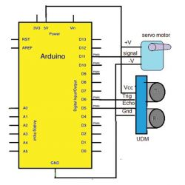

Slide 10
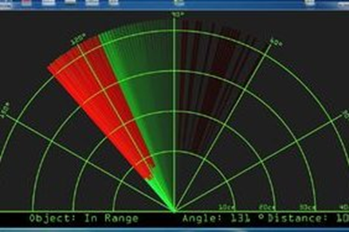

Slide 11
ADVANTAGES OF THE ARDUINO RADAR SENSOR
It is not affected by color or transparency. Basically, the Ultrasonic Sensors transmit the sound off of the object, hence the color and transparency have no effect on the radar reading.
Any dark environments have no effect on this Arduino radar sensor’s detection procedure. So, it can also use at night.
Easy to design and low price. The ultrasonic sensors are available at the market with very cheap price.
It has high frequency, high sensitivity, therefore, it can easily detect the external or deep objects.
This radar sensor is not affected by dust, rain, snow, and many more.
It has a self-cleaning system to continue running and less downtime.
The Arduino Radar Sensor is easy to use. Also, it is completely safe during the operation to nearby objects, human or equipment.
The Ultrasonic sensor can easily interface with any types of the microcontroller.

Slide 12
DISADVANTAGES AND LIMITATIONS
The Arduino Radar Sensor conduct sound to continue the work. So, it is not working in a vacuum as there is no air for the sound to travel through.
A very soft fabric can absorb more sound waves. Therefore, it is hard to detect objects which are covered with soft fabric.
If temperature changes of 5 to 10 degree or more then it is the effect on the sensing accuracy. Although this is true that there have many more temperature compensated sensors available.
Another limitation is the detection range. This depends on which Ultrasonic sensor have used to make the Arduino Radar Sensor.
While the radar using for inspection purpose, make sure it should be water resistive. Otherwise highly chances of damage.

Slide 13
THANK YOU

